Slide 1



Do you know what you own?
Notes:
-Intro -
Good evening, thank you for coming out tonight. The [department] is here serving and protecting the residents of [city name], but tonight I’m want to show you how you can protect your property.
How many of you know the serial numbers of your valuables like TVs, game systems, iPods/iPhones, computers, lawn equipment?
**show of hands**
Alight, that’s a problem! Let me give you a little insight why it’s a problem. But, I won’t leave you hanging. I’ll also show you how we can fix this.
When police reports are filed with our department for missing or stolen property, we need as much information as possible to help us identify the property in the recovery process. We’ll ask you for descriptions, photos and serial numbers. The more you can give us, the more information we’ll have to help us search for your property.
Make sense?
Slide 2

Slide 2
Register your
property online
Benefits:
It’s secure.
You can access the information from anywhere.
If there’s a theft or natural disaster, it will be invaluable to you, your insurance company and the detective working your case.
It’s FREE!
Notes:
Tell why keeping online record of property is important.
Key points:
Accessible from anywhere - Regardless of loss, theft or natural disaster, you’ll still be able to print out property information
Information is valuable to investigations
It’s FREE!
Now here’s how it works. Go to reportit.leadsonline.com.
Go to slide 3

Slide 3
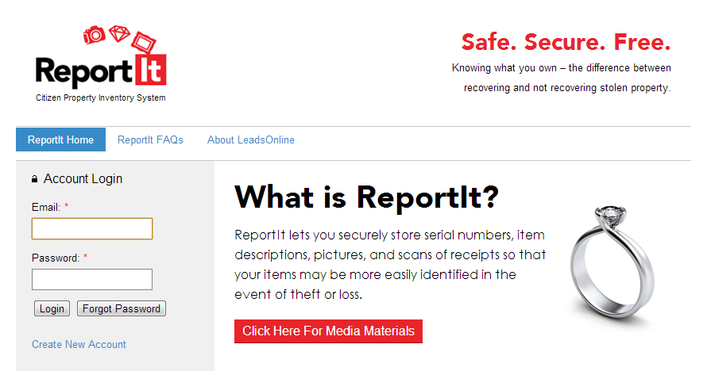
Go to
reportit.leadsonline.com
Notes:
Go to reportit.leadsonline.com and click on “Create new account”
Go to slide 4

Slide 4
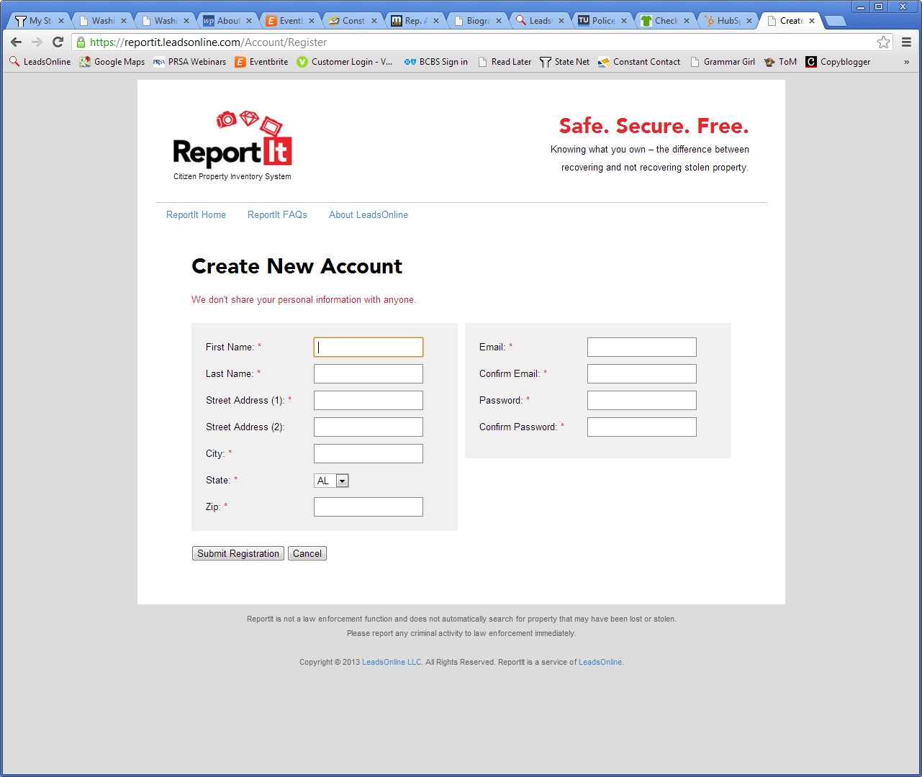
Create your free ReportIt account
Notes:
To create your account, fill out the required fields. LeadsOnline does not share your private information with anyone, not even law enforcement. It’s securely stored under the same protection that’s used by financial institutions and the government.
Click Submit.
Go to slide 5

Slide 5
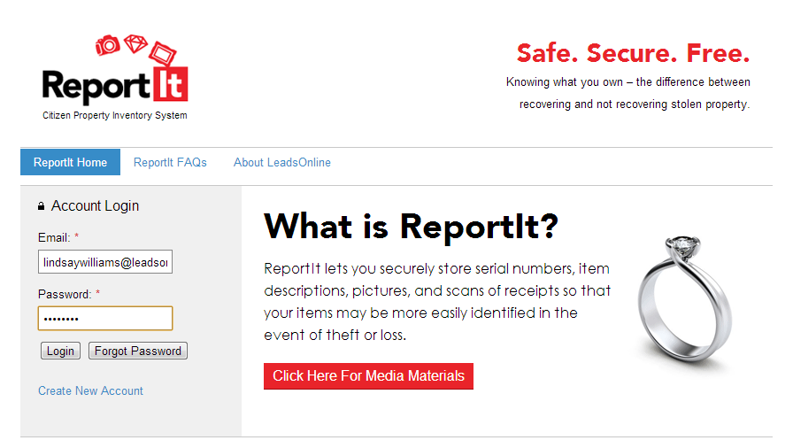
Login to your new
ReportIt account
Notes:
Once you have created a new account, you will be prompted to login with your newly created username and password.
Go to slide 6

Slide 6
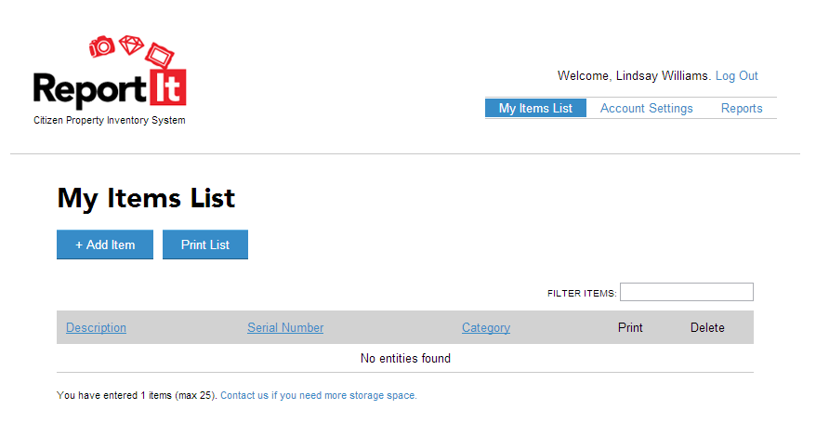
Start cataloguing
your property
Notes:
Click “Add New Item”
Go to slide 7

Slide 7
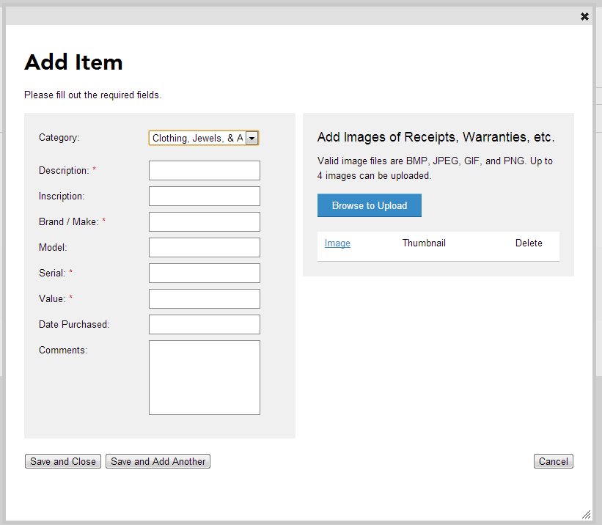
What makes your property unique?
Helpful hints:
Be specific.
Fill in as much information as possible.
Upload photos and scans of receipts. It’s especially important for jewelry and property that does not have a serial number.
Notes:
Click on “Enter New Item”.
On this screen, you will want to enter all of the information you have. If you have photos of you with the property or scans of receipts, this is the time to upload those.
If you upload an image, you’ll click on the blue “Browse to Upload”.
Once you have entered all of the property information for the first item, click “Save” or “Save and add another item”.
Go to slide 8.

Slide 8
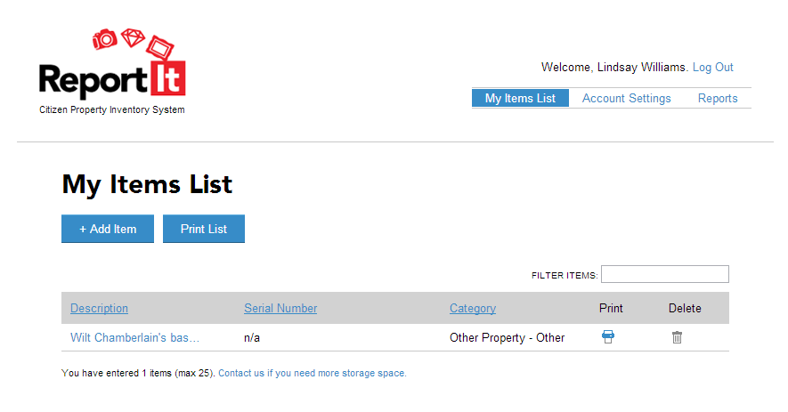
Print a report of
your property
Notes:
Click on the reports option at the
Go to slide 9.

Slide 9
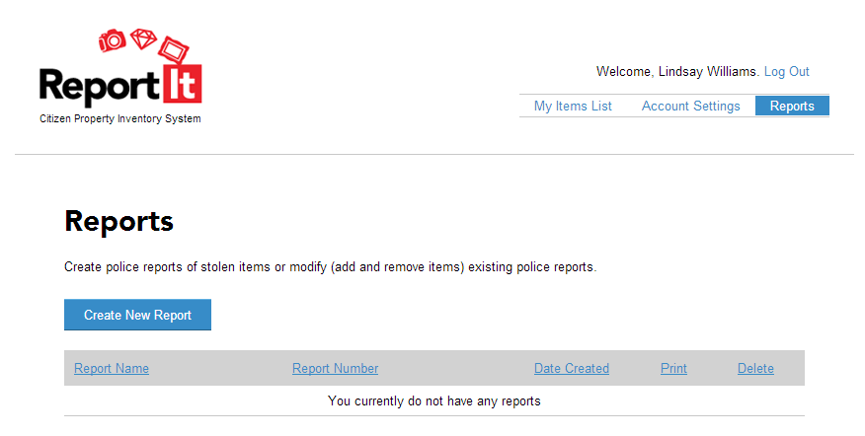
Print a report of
your property
Notes:
Click on the reports option at the
Go to slide 10.

Slide 10
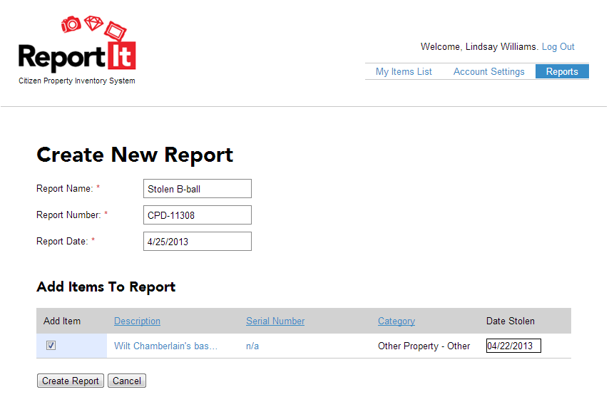
Customizing your report
Notes:
Here you’ll choose which items are missing, fill in the required information, and then click , “Create Report”. This will give you a report of all the information that you marked as stolen. Remember, this is all for your records and it’s up to you to send the information to your detective of insurance representative.
Go to slide 11.

Slide 11
FAQs Answered
How secure is the information I enter?
Are police able to search through the property I enter?
What type of property can I enter?
What does it cost to store my information?
Any other questions?
Notes:
How secure is the information I enter?
Answer: The information you enter is on a secure sockets layer (SSL) and password protected. The servers used to housed in the same facilities used by financial institutions and government agencies.
Are police able to search through the property I enter?
Answer: No. This is only for your records. Information cannot be accessed without your unique username and password.
What type of property can I enter?
Answer: Anything of value – think about collectibles, electronics, machinery, lawn equipment, and designer clothes and bags.
What does it cost for me to store my information?
Answer: It’s FREE!!!!
Go to slide 12.

Slide 12

Get started today!
Go to reportit.leadsonline.com
Notes:
How secure is the information I enter?
Answer: The information you enter is on a secure sockets layer (SSL) and password protected. The servers used to housed in the same facilities used by financial institutions and government agencies.
Are police able to search through the property I enter?
Answer: No. This is only for your records. Information cannot be accessed without your unique username and password.
What type of property can I enter?
Answer: Anything of value – think about collectibles, electronics, machinery, lawn equipment, and designer clothes and bags.
What does it cost for me to store my information?
Answer: It’s FREE!!!!

